Slide 1














ANIME
EMOTION
DETECTION
MODEL
By Group 8
/

Slide 2


ABOUT
US
We are: Nirup Makwana
Odeleye Samuel
01

Slide 3

INTRODUCTION
Emotions are a crucial part of our day to day lives, especially when it comes to conveying them in an effective way

Slide 4

EMOTIONS ARE UNIQUE
Emotion recognition is the process of identifying and interpreting human emotions. Traditionally, this has been a skill humans excel at, relying on facial expressions, body language, and tone of voice.
HOWEVER,
...recent advancements in artificial intelligence have enabled machines to analyze these cues and recognize emotions with increasing accuracy.

Slide 5

A PICTURE IS WORTH A THOUSAND WORDS

Slide 6

PROBLEM
STATEMENT

Slide 7

CAPTURING EMOTION
Whilst movies can implement this efficiently through human actors, it can get a little difficult when it comes to animation, especially when it comes to animating over many frames with animators generally using real life references to draw over.

Slide 8



PROBLEM, MEET SOLUTION
problem
SOLUTION!
Capturing emotions is critical to storytelling; accurate emotion classification is crucial for visual storytelling, enhancing user experiences, and supporting content creators.
We aim to develop a machine learning model able to classify emotions from art, especially anime.
The model will identify emotions such as happiness, sadness, anger, and surprise from a given image.

Slide 9

02
DATASET
AND METHODOLOGY

Slide 10

"Learn the rules like a pro, so you can break them like an artist."
—PABLO PICASSO

Slide 11
21,551
Big numbers catch your audience’s attention
anime faces scraped
from www.getchu.com
https://www.kaggle.com/datasets/soumikrakshit/anime-faces

Slide 12


DATA PREPROCESSING
RESCALE
SPLIT
The images are loaded from directories using ImageDataGenerator, pixel values are rescaled by dividing them by 255.
The images are divided into training, validation, and testing datasets, with different directories for each.
AUGMENTATION:
LOADING
Rotation: ~40 degrees
Shear: 30% range
Zoom: Randomly within 30%
Flips
The flow_from_directory function is used to load images in batches from the specified directories

Slide 13
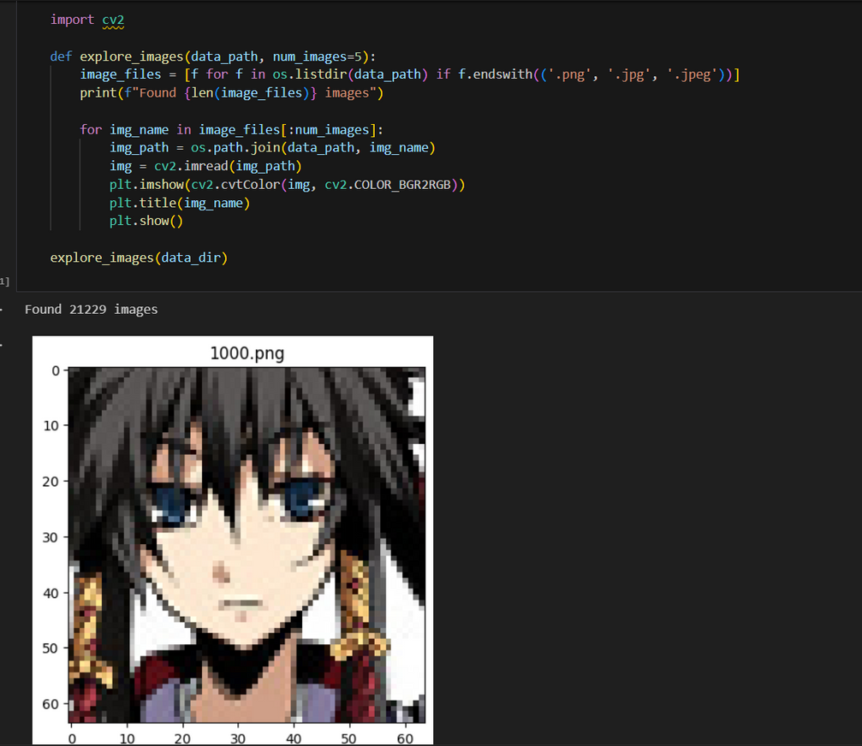

CAVEAT:
SUPERVISED TRAINING
The data had to be manually labeled due to performance constraints and the pre-trained model used MobileNetV2 had some trouble with classifying Anime characters images

Slide 14
CNN MODEL STRUCTURE
01
02
Convolutional Layers
Pooling Layers
MaxPooling2D layers are used after each convolutional layer to downsample the feature maps
Four Conv2D layers with increasing filter sizes and a 3x3 kernel, followed by ReLU activations
04
03
Fully Connected Layers:
Flatten Layer
converts the 2D matrix into a 1D vector to be fed into the Dense layers
A final Dense layer with 1 unit and sigmoid activation for binary classification

Slide 15
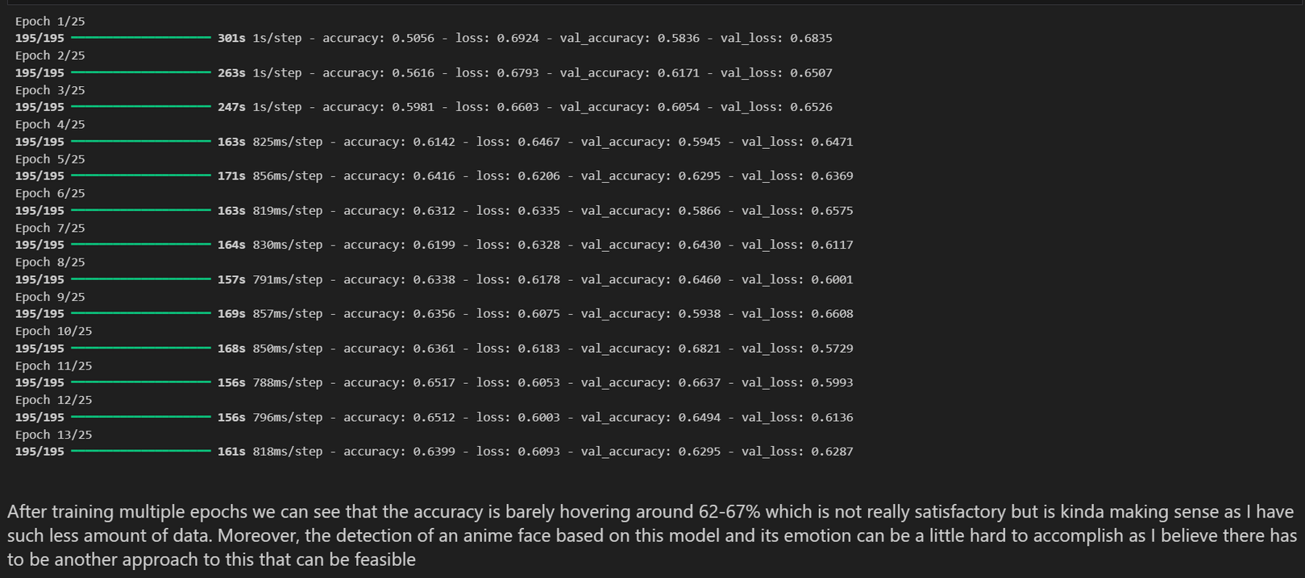

Model is trained for 25 epochs
(or until early stopping is triggered)
using the training data, performance is
validated on the validation data.

Slide 16
03
METRICS
How well does the model perform?

Slide 17

EVALUATION METRICS
 | PRECISION | RECALL | F1 SCORE | SUPPORT
Happy | 0.50 | 0.60 | 0.54 | 219
Neutral | 0.50 | 0.40 | 0.44 | 219
Accuracy |  |  | 0.50 | 438
Macro avg | 0.50 | 0.50 | 0.49 | 438
Weighted avg | 0.50 | 0.50 | 0.49 | 438

Slide 18
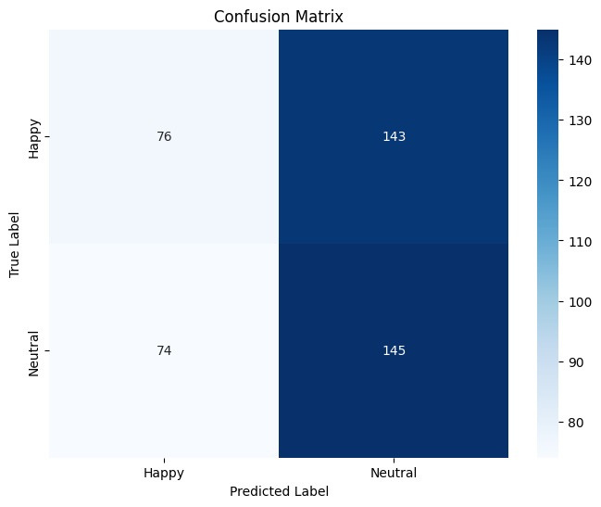
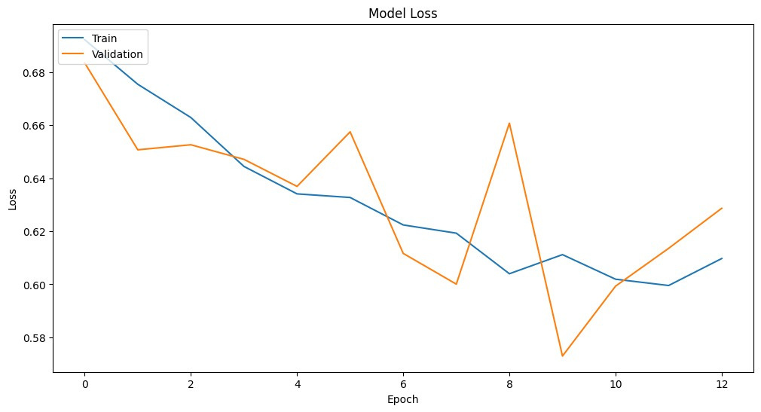
VISUAL ANALYSIS
CONFUSION MATRIX
MODEL LOSS

Slide 19
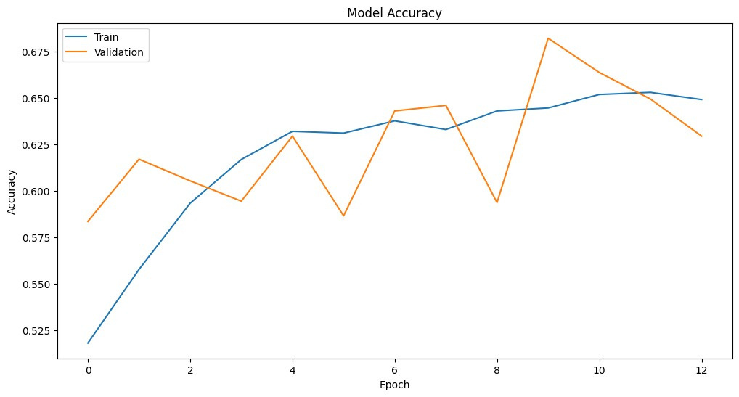
HOW ABOUT... ACCURACY?

Slide 20

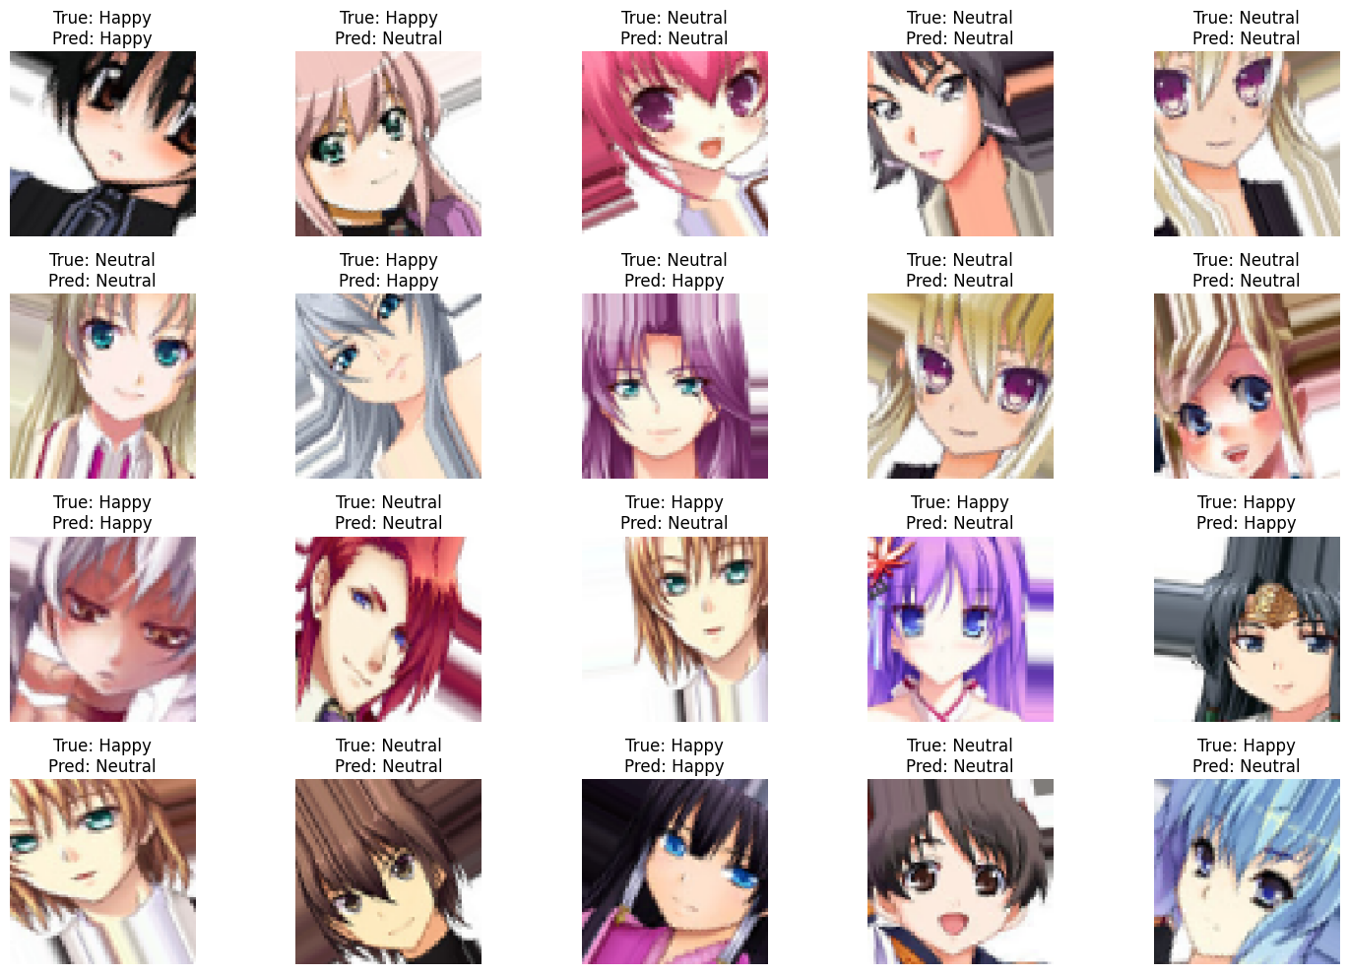
OUTPUT?
NEEDS MORE WORK...
With a more streamline process and a pre-trained facial model
...but it’s a start!
We will be further improving this model as we believe there is some potential

Slide 21
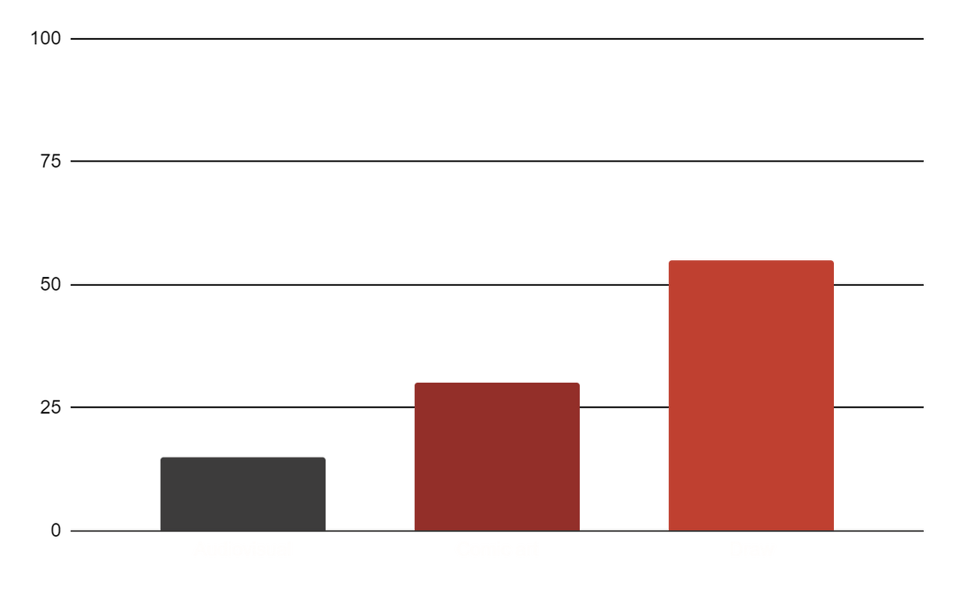
APPLICATION AREAS
ANIMATION
streamline workflow by automatically tagging and organizing scenes based on emotional content
15%
STREAMING
30%
Personalized assistance and recommendations
ENGAGEMENT
55%
Teach students about facial expressions and emotions in a culturally relevant way.

Slide 22
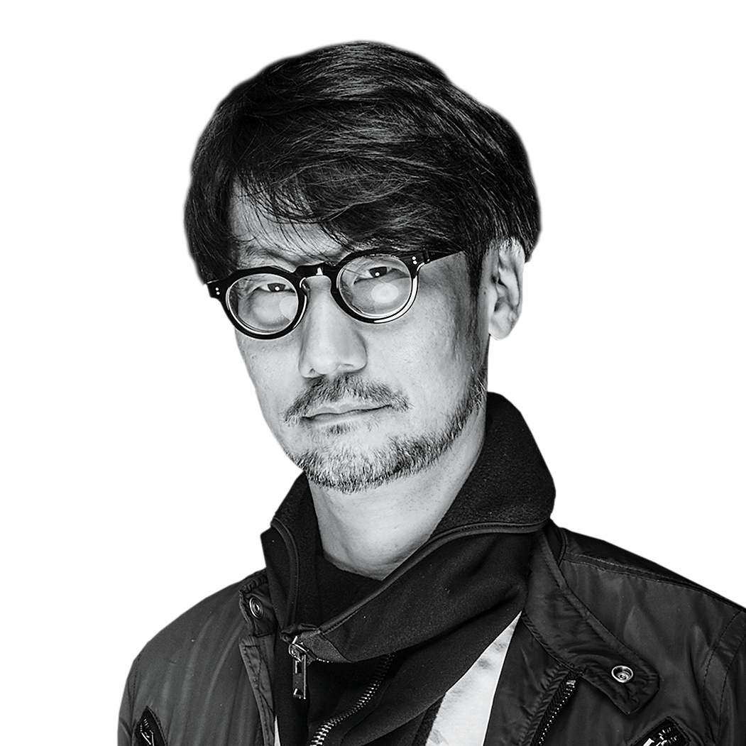
“That’s why I read books, watch movies, and listen to music. I go to art and history museums. I meet people. That repeated process is the only way to learn from history and create the future.”
—HIDEO KOJIMA

Slide 23


THANKS!
QUESTIONS?

